Slide 1
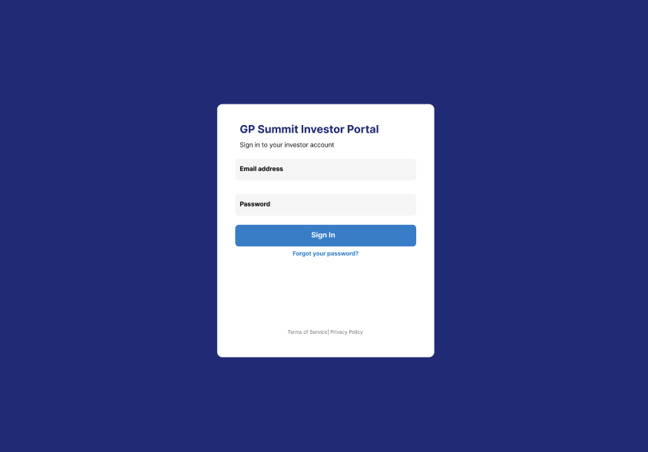
Notes:
RD FEEDBACK NOTES (March 20, 2026):
Update line to ‘Sign in to your account:’ / the reason being that this screen can be used by all roles (GP, Admin, LP, and Founders), so we can have one generic screen
For this solution, let’s update the Main Title to: ‘Startup TNT Investor Portal’ for the login screen as this is the current objective.

Slide 2
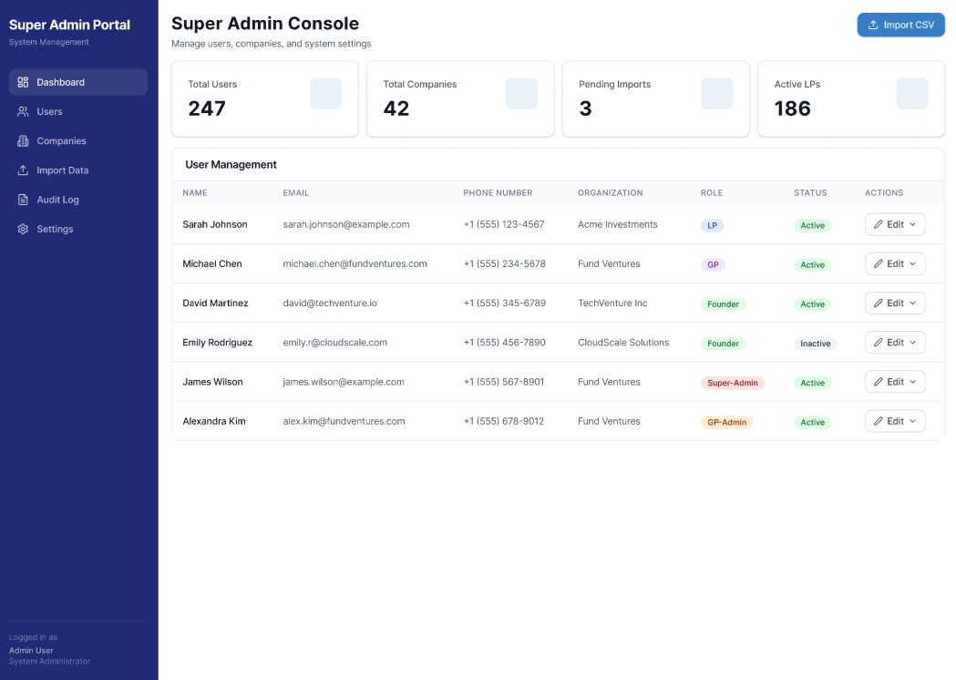
Notes:
RD FEEDBACK NOTES (March 20, 2026):
Feature Add: I am thinking that it would be a positive to have a ‘Message’ icon and button and to provide for a simple embedded messaging capability. Perhaps an active icon could be provided on the left side of the contact email. An embedded email (internal message) tool could be a plus for direct communication. When a message is created, it could prompt email to the user to sign into the portal to review the message, so that messages are maintained within the solution.

Slide 3
Notes:
RD FEEDBACK NOTES (March 20, 2026):
Update line to ‘Sign in to your account:’ / the reason being that this screen can be used by all roles (GP, Admin, LP, and Founders), so we can have one generic screen

Slide 4
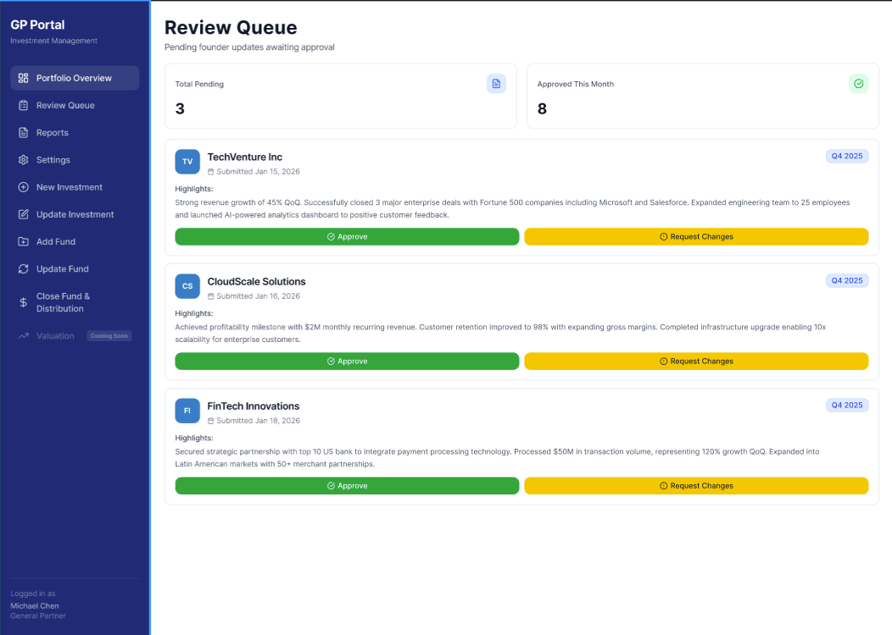
Notes:
RD FEEDBACK NOTES (March 20, 2026):
Logic point notes: Good outline on this page. But there would be 3 states for the Review Queue:
(1) Current queued items (pending)
(2) Company which GP is asking for changes (Request Changes)… so a third button may be needed which would be in a ‘blue’ state of ‘Waiting for Response to Changes’
APPROVE: would place the item into an updated state, and the item would be removed from the queue from being displayed in this area
REQUEST CHANGE: would bring up a separate dialog box (or screen) which would provide a messaging opportunity for the GP to ask the Founder to provide update… this could be a simple messaging type of opportunity and the Listed Item would provide for a ‘Blue’ button reference – moving the item into ‘Waiting for Response to Changes’ state.
(3) Waiting for Response to Changes:

Slide 5
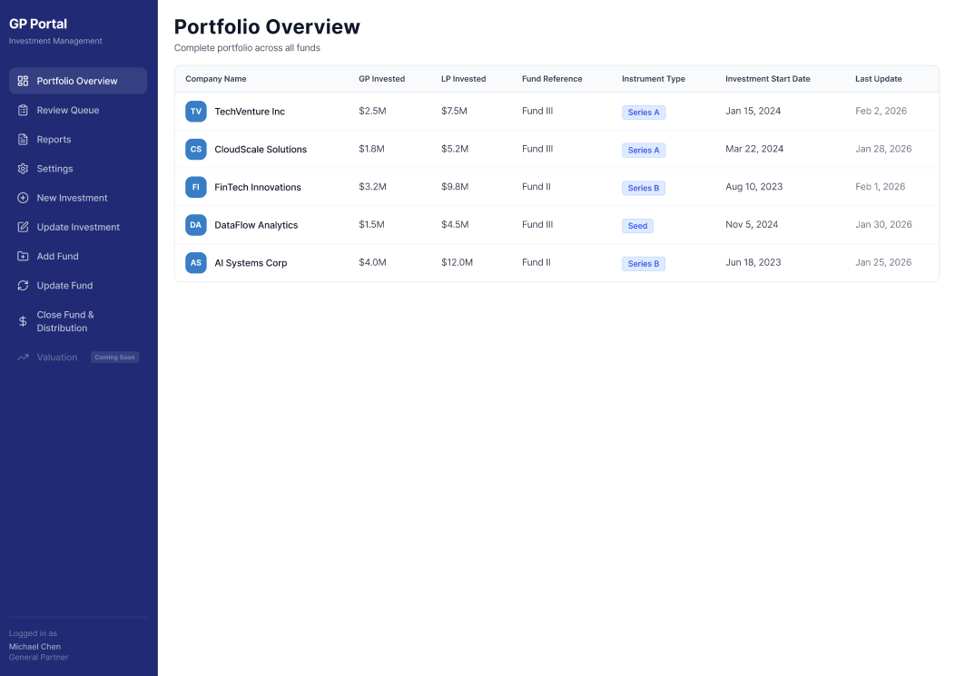
Notes:
RD FEEDBACK NOTES (March 20, 2026):
For GPs, I think we will want to have some Filter options here where the GPs could see dashboard of (A) Funds; (B) Summits; and (C) Companies / this current page is company oriented and presuming we could have some sort features (i.e. alphabetical, numerical, Instrument types etc).
For awareness – TNT (as example) has only created two Funds over time, and that may increase over time… and the Funds invest in multiple companies over the course of the year (or period of time)
Summits – typically there is only a single company (winner) for a Summit-based investment… but at the Summits, investors may also contribute to separate (finalist) companies in ‘Side-deals’ / in all cases the companies are the most fundamental (base level) investments that are (become) invested

Slide 6
Notes:
RD FEEDBACK NOTES (March 20, 2026):
Update line to ‘Sign in to your account:’ / the reason being that this screen can be used by all roles (GP, Admin, LP, and Founders), so we can have one generic screen

Slide 7
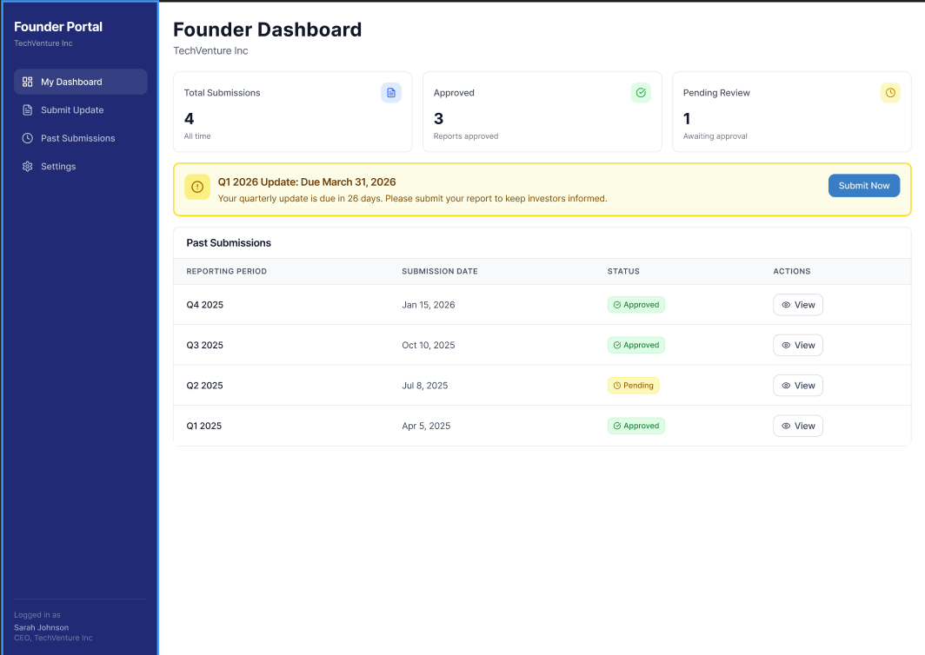
Notes:
RD FEEDBACK NOTES (March 20, 2026):
Per earlier reference notes from GP… there could also be a third state ‘blue’ which is indicted as ‘Change Request’… and rather then a ‘View’ button, there could be an ‘Edit’ button also indicated in ‘blue’ and where the Founder can select and then be taken to the appropriate record which can / should be edited…
Where the Edit is being made, notes from the GP can be presented and the Founder can do two things (1) Make changes as requested, which could be information update, or new PDF upload; and (2) Founder can provide a note regarding (text message type) for the update to indicate briefly the changes that were made.

Slide 8
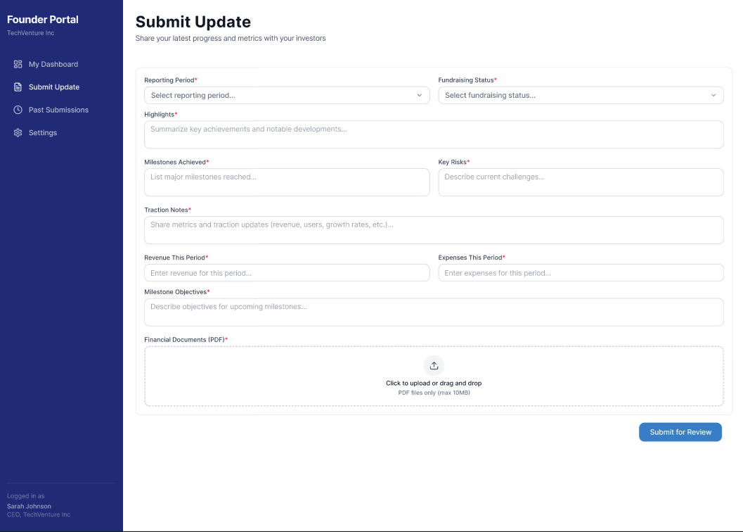
Notes:
RD FEEDBACK NOTES (March 20, 2026):
On this page, which is about Founder’s providing reports, I think that the Title is ‘Submit New Report’ rather than ‘Submit Update’… and same update needed in the menu item as it is ‘Submit New Report’
On the Past Submissions menu, records of past submissions can be indicated as line-item records.
A Box could be provided for: Number of months remaining for existing cashflow:
Boxes on single line could be provided for: Number of FTE Resources Number of Part-time Resources Number of Contractors
Rather than ‘Financial Documents (PDF)’ – could be Upload Current P&L, Balance Sheet, and MDA files (PDF format)
On the Left side below last box, could provide for a Button which would be ‘Download Templates’

Slide 9
Notes:
RD FEEDBACK NOTES (March 20, 2026):
Update line to ‘Sign in to your account:’ / the reason being that this screen can be used by all roles (GP, Admin, LP, and Founders), so we can have one generic screen

Slide 10
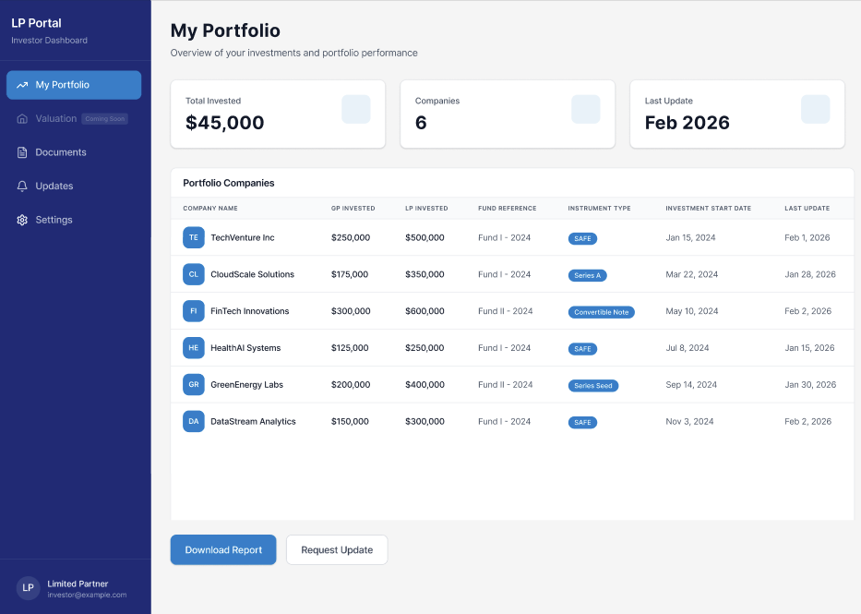
Notes:
RD FEEDBACK NOTES (March 20, 2026):
xxxxxx

Slide 11
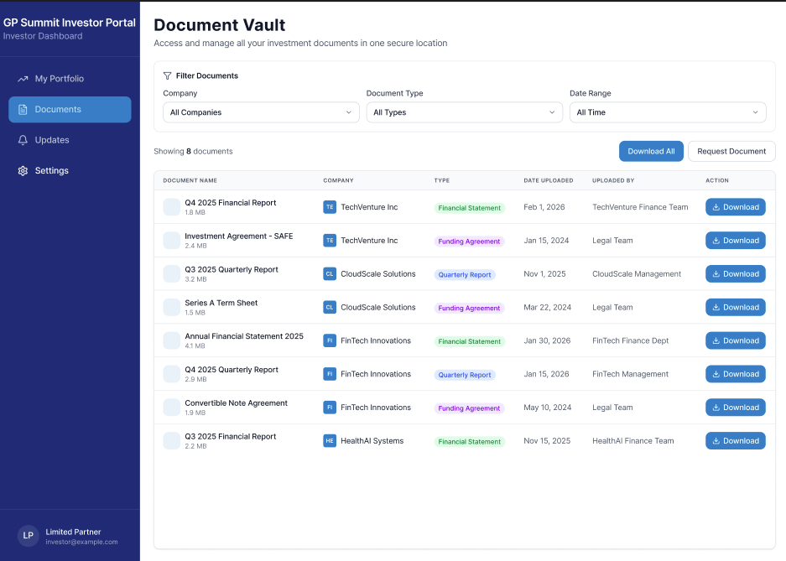
Notes:
RD FEEDBACK NOTES (March 20, 2026):
Note that for this screen: (A) LPs should only be able to see companies, and related documents that they have invested in; so this page should be ‘Role’ specific.
For Founders, they should only be able to see the Documents that they have provided or submitted, which could include both first submitted files, as well as any Update materials that they may have provided
For GPs (and GP Admins) they should be able to see ALL documents as they exist at the top-level of the Organization
For LPs, they should be able to only see documents that they have rights to (i.e. Funds, Summits, or Companies)… for awareness, Funds invest into multiple Summits and/or Companies, but the GPs would indicate those as Transactions in their Portal access… so every Fund, Summit, and Companies will each have unique Identifiers.
Companies can be invested by LPs via ‘Funds’ or via ‘Summits’ or via ‘Side deals’ (directly by LPs)… in each these are all at the basic level transactions.

Slide 12
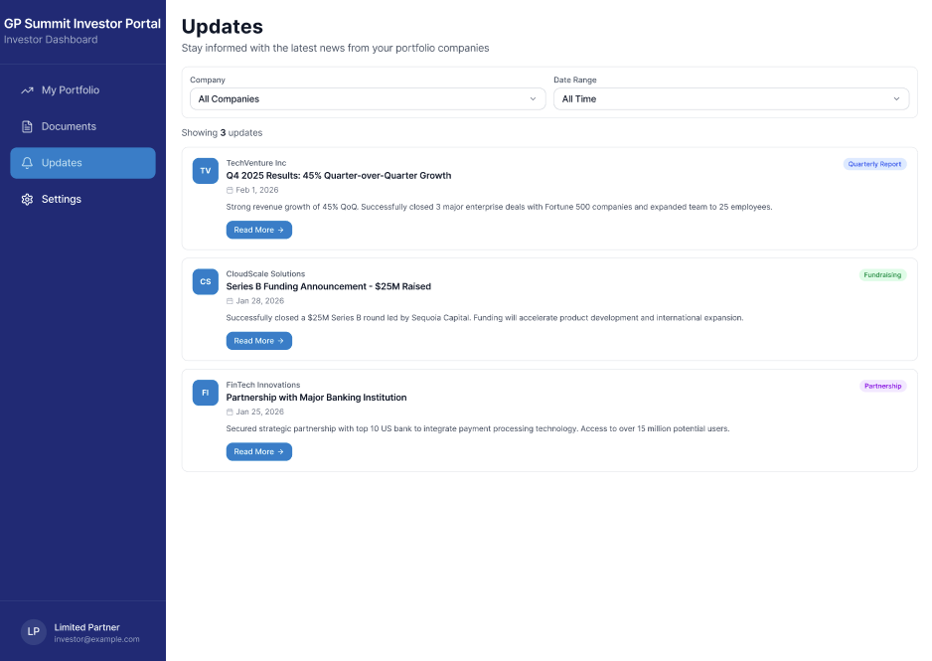
Notes:
RD FEEDBACK NOTES (March 20, 2026):
Much like other platforms like this, people might want to STAR records, or ‘Mark as Read’ or ‘Mark as Unread’
Rather than ‘Company’ at the top – we might want to have ‘Filter’ and the filter can be ‘Funds’ or ‘Summits’ or ‘Companies’
Date range is a plus, but we might also want to have a ‘Search’ function as well

